Slide 1

RUNGTA COLLEGE OF DENTAL SCIENCES AND RESEARCH
ENDODONTIC INSTRUMENTS
DEPARTMENT OF CONSERVATIVE DENTISTRY AND ENDODONTICS

Slide 2
Specific learning Objectives
At the end of this presentation the learner is expected to know ;
Core areas* | Domain ** | Category #
History | Cognitive | Nice to know
Color coding of instruments | Cognitive | Must know
Hand instruments | Cognitive | Must know

Slide 3
Content
Standardization of Instruments given by Ingle and Levine
Classification of Endodontic Instruments
Group I Hand-operated Instruments
Files
Group II Low Speed Instruments with Latch-Type Design
Group III Engine-Driven Instruments
Generations of NiTi Rotary Files
First Generation NiTi Rotary Files
Second Generation
Third Generation Files
Fourth Generation Reciprocating Instruments
Fifth Generation Instruments
Scout Race Files
Group IV Sonics and Ultrasonics in Endodontics
Sonic Handpiece
Instrument Deformation and Breakage
Instruments Used for Filling Root Canals

Slide 4
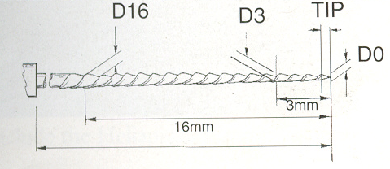

Slide 5
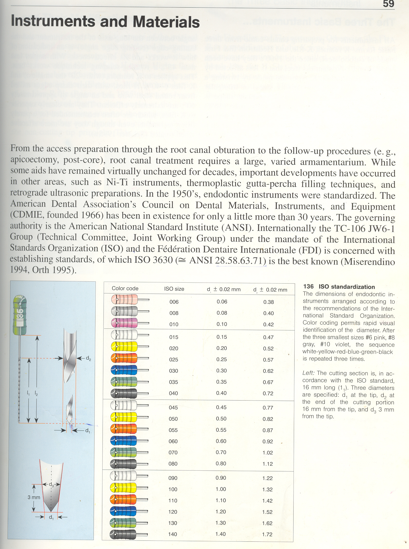
COLOUR CODING:
The International Standards Organisation (ISO) recommended a colour coding system
For easier recognition
Consists of 6 colours chosen in ascending order of size from light to dark
Small sized instruments (06, 08) were also added and colour coded as pink, grey respectively.
GROUP 1

Slide 6
GROUP 2
These colours are repeated in each of the three groups
Change in D1
  06−10 0.02 mm
  10−60 0.05 mm
  60−160 0.10 mm
GROUP 3

Slide 7
GROUPS | NUMBER OF INSTRUMENT | COLOUR CODING
 | 06 08 10 | Pink Grey Purple
GROUP I | 15 20 25 30 35 40 | White Yellow Red Blue Green Black
GROUP II | 45 50 55 60 70 80 | White Yellow Red Blue Green Black

Slide 8
GROUPS | NUMBER OF INSTRUMENT | COLOUR CODING
GROUP III | 90 100 110 120 130 140 150 | White Yellow Red Blue Green Black White

Slide 9
Instrument length:
Measured from the instrument tip to the end of the shank (l₂)
Manufactured in four lengths
  Standard − 25 mm
  Long − 28 mm and 31 mm
  (useful in canines)
  Short − 21 mm
  (used in 2nd and 3rd molars or restricted mouth opening)
Although instruments are available in various lengths, the working end of the instrument
(length of the cutting segment, l₁ )
remains constant is 16 mm.

Slide 10
Disadvantages of the present ISO standardization:
Percentage difference between successive instruments
  Between number 10 and number 15 instruments there is a change of 50%
  While on the other hand between number 50 and number 60 instrument the percentage difference a mere 9%

Slide 11
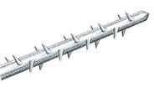
HAND INSTRUMENTS
BARBED BROACHES AND RASPS:
ANSI Specification No. 63
ISO-FDI No. 3630−1
differs from standardization of H-type or K-type instruments because of the taper and length of the working portion of the shaft (10 mm)
The major difference between broaches and rasps lies in the depth and angle of cut in the wire shaft (core)

Slide 12
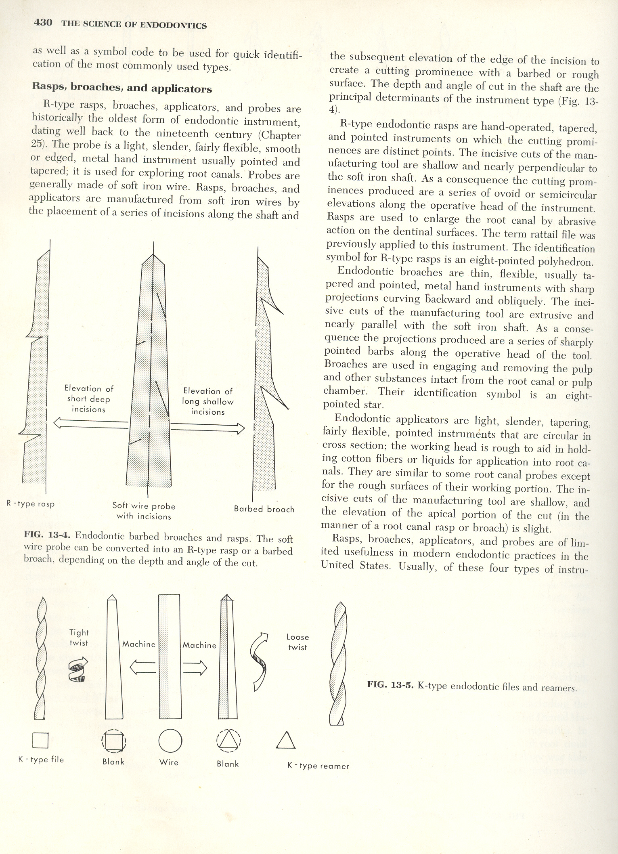
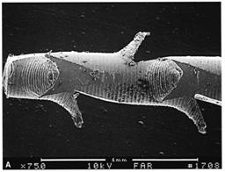
Broaches have greater depth of cut
  the remaining core thickness is much reduced
  resulting in more fragile instruments throughout its working length
  making it more susceptible to fracture if used continuously

Slide 13
 | BARBED BROACHES | RASPS
Barb height equal to | ½ the core diameter is larger | One third tip diameter
Taper | 0.007 to 0.010 mm per mm (less taper) | 0.015 to 0.020 mm per mm (more taper)
Number of barbs | About 40 (exceptionally fine) hence weaker | 50 to 60; blunt
Length of working end | 9 to 10.5 mm, till the last broach | relatively short

Slide 14
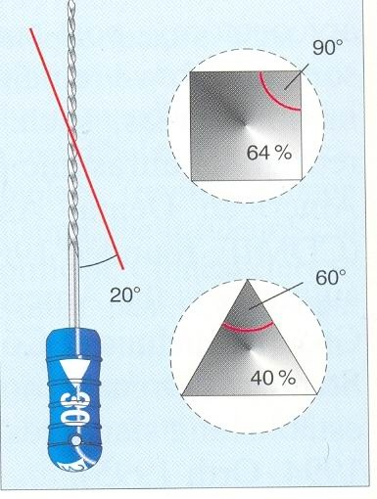
K−REAMER
CHARACTERISTIC FEATURES:
Have ½ to 1 cutting blade per mm
Made from either triangular or square blank
  SMALLER SIZES -SQUARE
  LARGER SIZES –TRIANGULAR
Triangular cross section is more flexible
Angle of blades to long axis is 20 degree
Have fewer cutting blades than K-files.
Primarily designed to be used in a rotary reaming motion

Slide 15
CUTTING ACTION OF K-REAMER :
They are twisted clockwise about one quarter turn to one half turn to engage their blades into dentin and then withdrawn
  In a straight canal – one half turn
  In curved canals - one quarter turn
The instrument produces a round taped preparation
Reamers are almost completely out of clinical practice now a days.

Slide 16
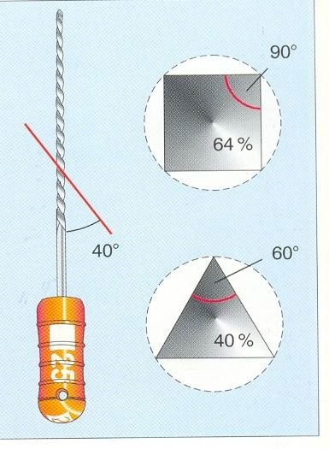
K-FILES
ADA/ANSI SPECIFICATION No. 28
CHARACTERISTIC FEATURES:
K-files have 1 ½ to 2 ½ cutting blades per mm of their working end
About twice the number of spirals on a K- reamer of corresponding size
Angle of the flutes to the long axis is about 25-40 degree
Thus, like reamers they are primarily designed to be used in rotary reaming motion.

Slide 17
CUTTING ACTION OF K-FILES :
The tighter spirals establishes a cutting angle that achieve its principle cutting action on withdrawal
It can even cut in the push motion
The cutting action of the file can be achieved in either a filing (rasping) or reaming (drilling) motion

Slide 19
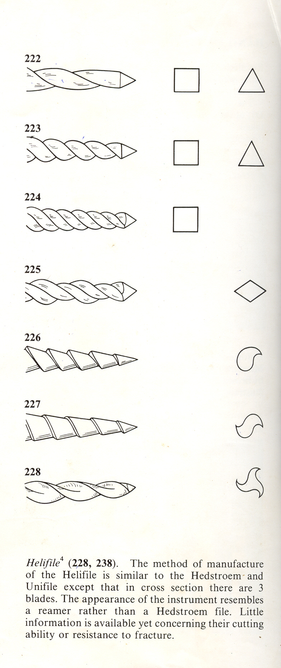
K reamer
K file

Slide 20
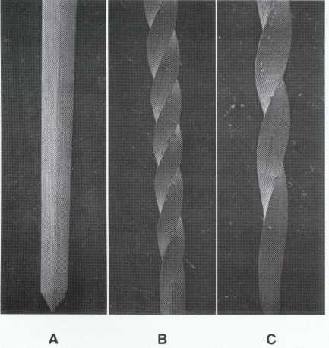
Blank
File
Reamer

Slide 21
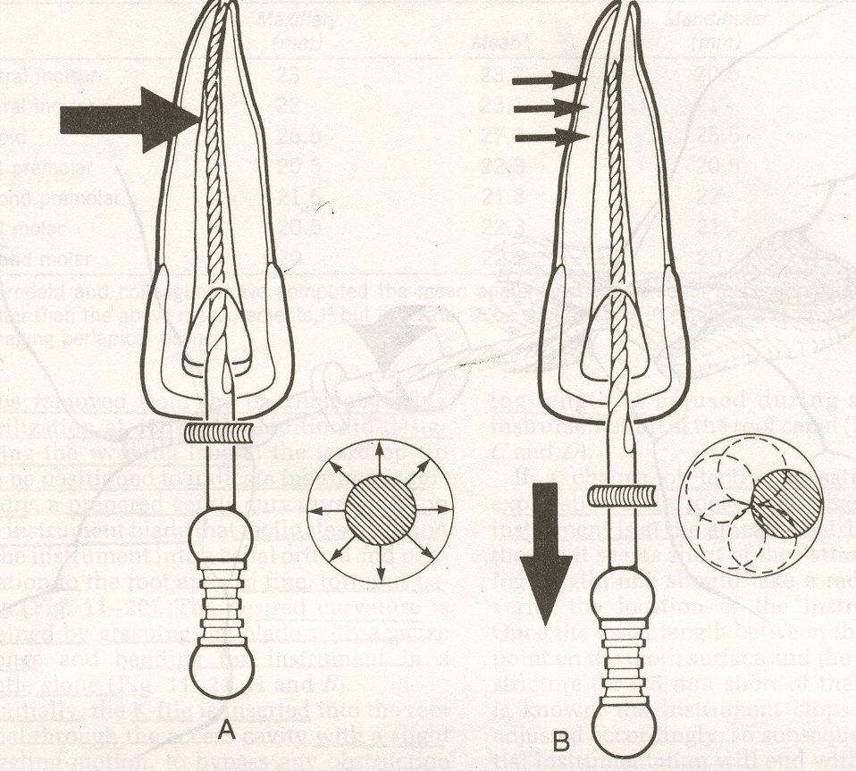
FILING MOTION
  The instrument is placed into the canal at desired length
  pressure exerted against the canal wall
  while this pressure is maintained, the instrument is withdrawn without turning

Slide 22
K-FLEXFILES
Has a rhomboidal or diamond cross section with
2 acute angles
2 obtuse angles
Has only two cutting edges
But is more flexible

Slide 23
The high flutes are formed by the two acute angles of the rhombus
  present increased sharpness and cutting efficiency.
The alternating low flutes formed by the obtuse angles of the rhombus
  provides more area for increased debris removal.
They are more flexible.

Slide 24

FLEX-O-FILES
Non cutting tip
Made of flexible stainless steel
Triangular cross section
Is flexible
Should be used with a lateral scrape on the mesial surface

Slide 25


Flexo files
Flexo Files
Flexo Golden Mediums

Slide 26
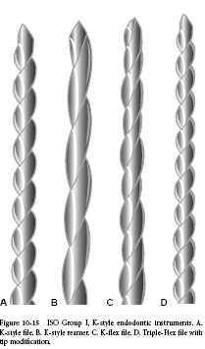
K-Style Endodontic Instruments:
K-Style File
K-Style Reamer
K-Flex
Triple Flex File modified Tip

Slide 27
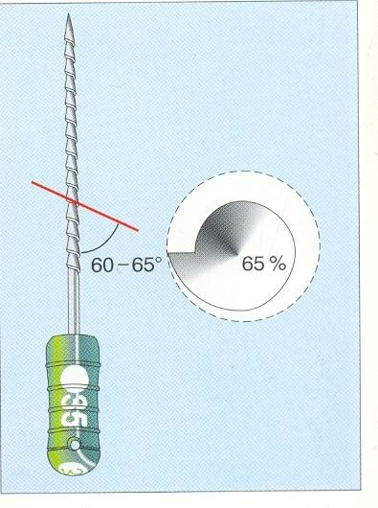
HEDSTROEM FILES
ANSI No. 58
ISO No. 3630/1
Also known as H-type files
Has a characteristic Christmas tree appearance (with spiral cutting surface winding up the shaft)
The angle between cutting edge and the long axis of the instrument is about 60-65 degree.
Used for planing the canal from the apical region to the occlusal / incisal orifice

Slide 28
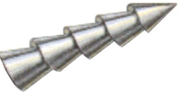
Periphery bears spiral grooves (like a screw)
Single helix tear drop appearance in cross section

Slide 29
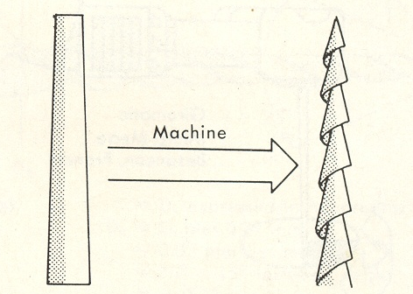
The spiraling flutes with the cutting blades are produced by machining a single helix into the shaft of a piece of round tapered stainless steel wire

Slide 30
CUTTING ACTION OF HEDSTROEM FILES:
Designed primarily for a linear filing motion
Due to the positive rake angle, they cut in only one direction, during retraction (withdrawal stroke)
Unsuitable to be used in rotary or reaming motion, due to its greater fragility

Slide 31
Modifications of Hedstroem files
  Unifile
  Helifile
DOUBLE HELIX
TRIPLE HELIX

Slide 32
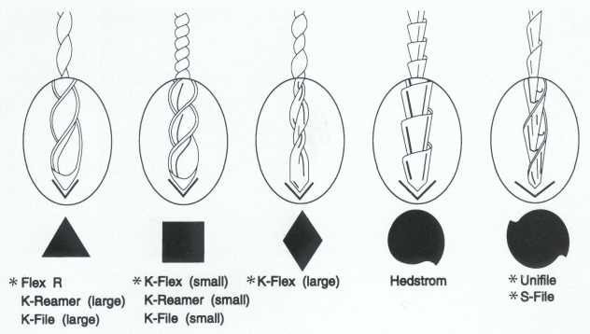

Slide 33
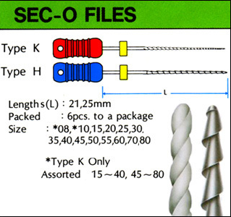
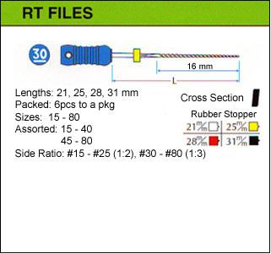
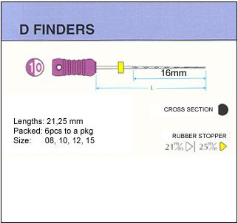
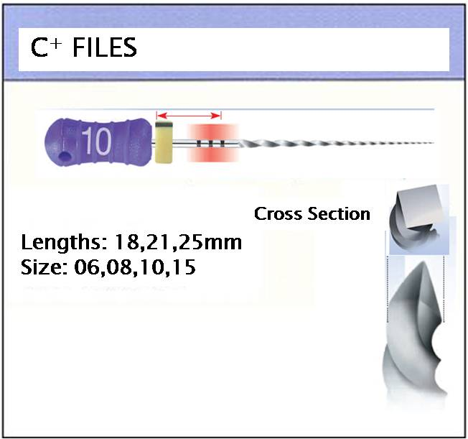

Slide 34
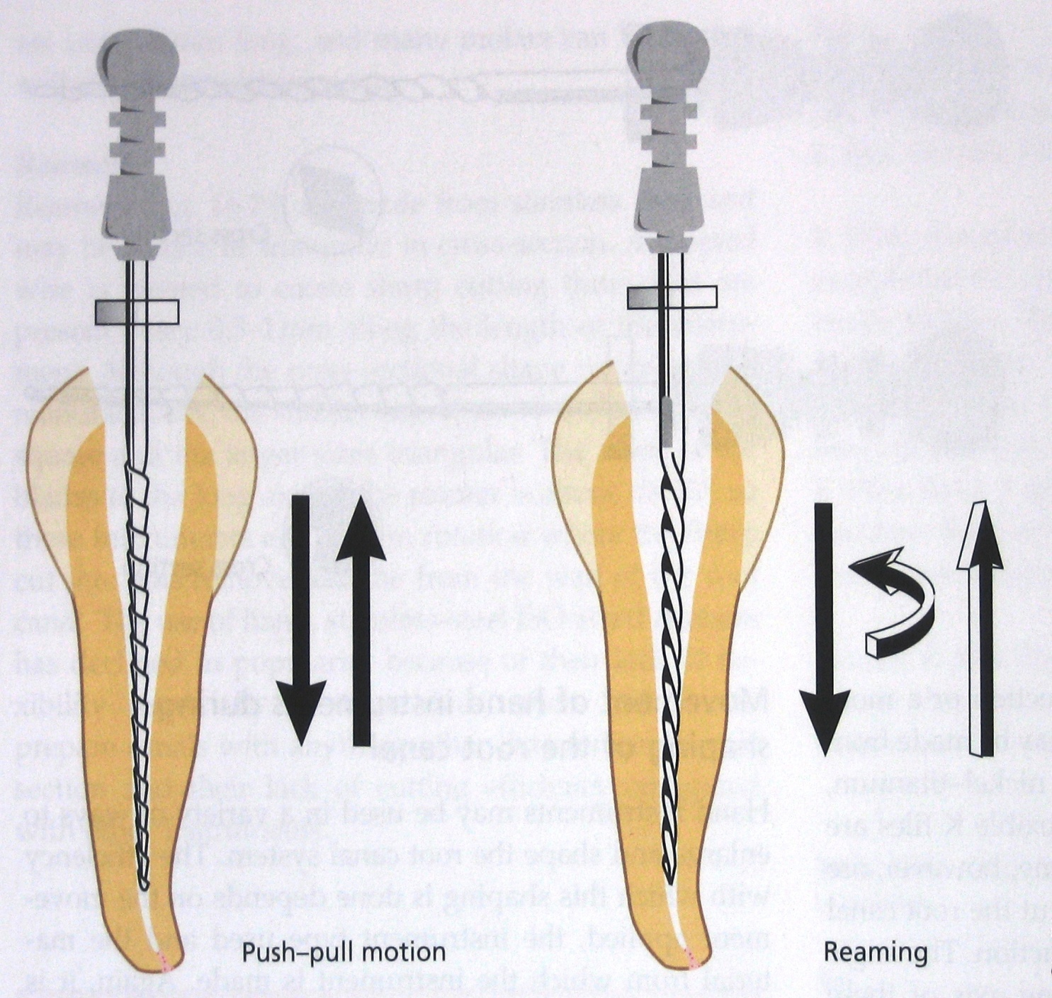

Slide 35
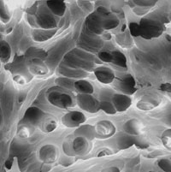
TAKE HOME MESSAGE
From a biological perspective, root canal treatment is directed toward the elimination of micro-organisms from the root canal system and the prevention of reinfection.
Technological advances in the form of rotary NiTi instruments have led to dramatic improvements in the ability to shape root canals with potentially fewer procedural complications.

Slide 36
QUESTIONS
What are the color coding of hand instruments used?
Give the difference between K file and H file.

Slide 37
REFERENCES
Endodontic Practice 11th Edn. Grossman
Pathways Of The Pulp 6th Edn. & 9th Edn. Cohen
Endodontics Vol 1 Arnaldo Castellucci
Endodontics Ingle 5th Edn.
Text book of Endodontology Bergenholtz Reitz
Endodontic Therapy Weine 5th Edition
Color atlas of Endodontics William Johnson
Principles and practice of Endodontics- Walton &Torabinejad
Color Atlas of Microsurgery in Endodontics Syngcuk Kim
Textbook of Endodontics Nisha Garg Amit Garg

Slide 38
THANKYOU

